Slide 1
Medical terminology spring 2022 semester
Westside high school
January 2022
Dr. anna haro

Slide 2
Course Re-introduction
Welcome back to Medical Terminology!
My name is Dr. Haro and you can call me Dr. Haro or Dr. H.
This is my 7th year in public education and 4rd year in HISD. I also taught for 3 years at Texas A&M University in the RCOP.
I have been a pharmacist for 16 years. I earned my Doctor of Pharmacy Degree from the Chicago College of Pharmacy at Midwestern University.
I am HERE at Westside HS for two reasons: 1. I LOVE to teach!!! And 2. My son is down the street at Daily Elementary School. I also have a 5 y.o. daughter and the teaching schedule allows for flexibility and more time with my family and children.
Whenever you have ANY questions, feel free to reach me via Remind app, via email, or during office hours on MS TEAMS.

Slide 3
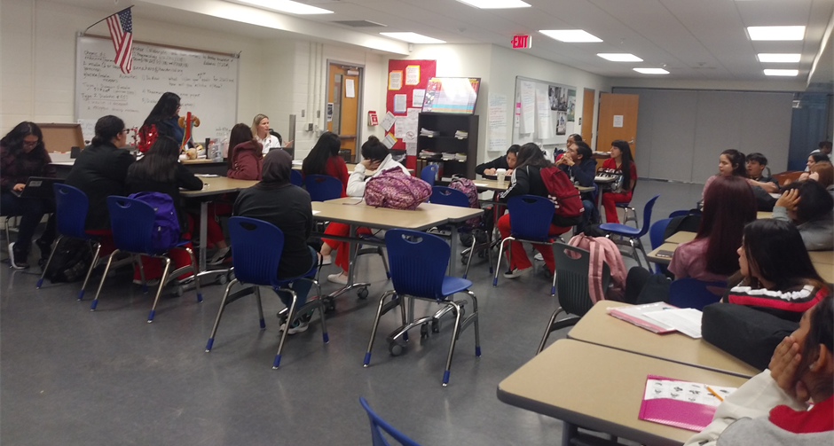
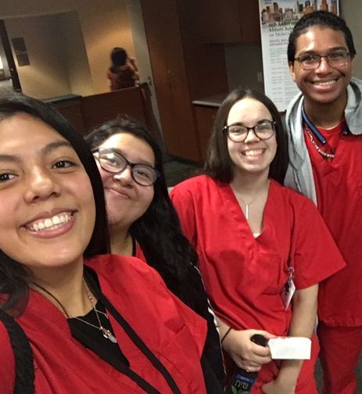
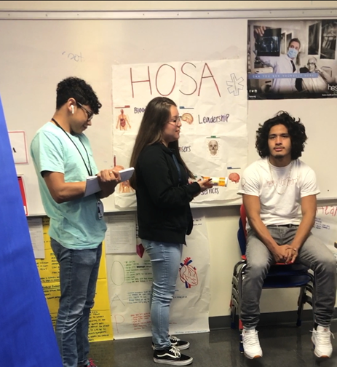
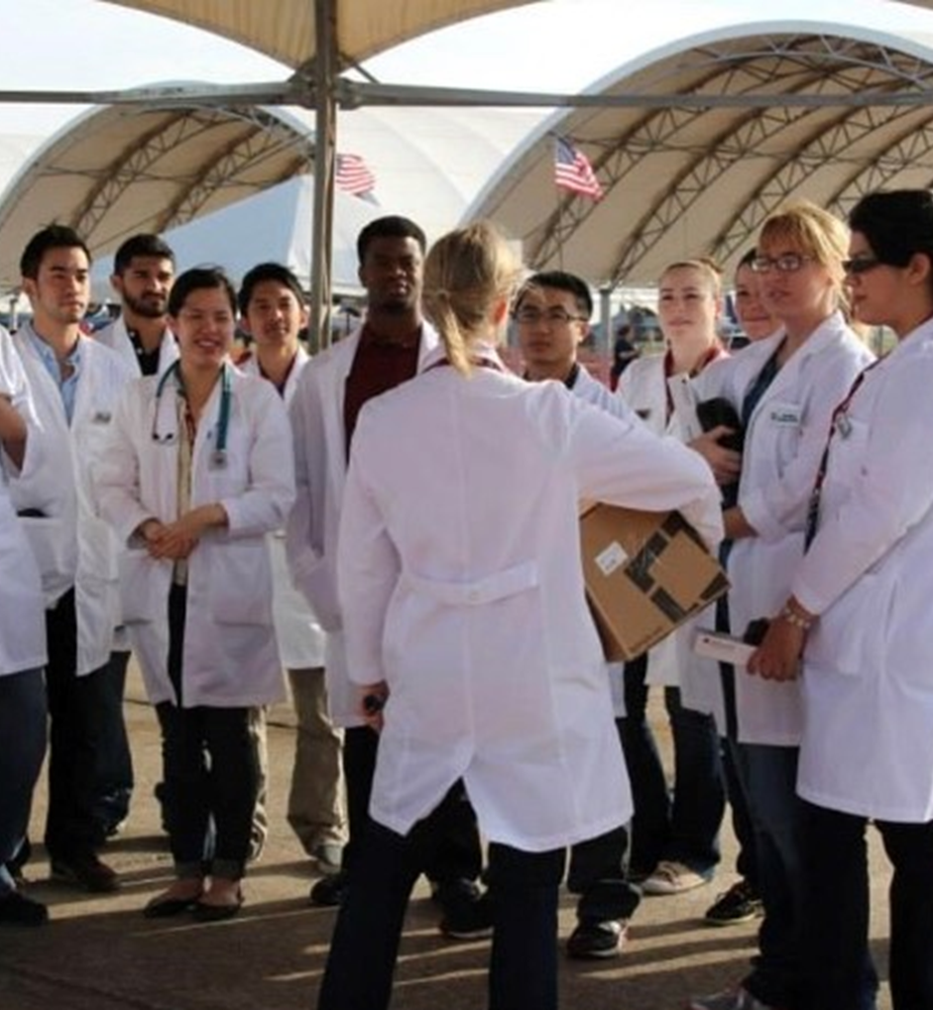

Slide 4
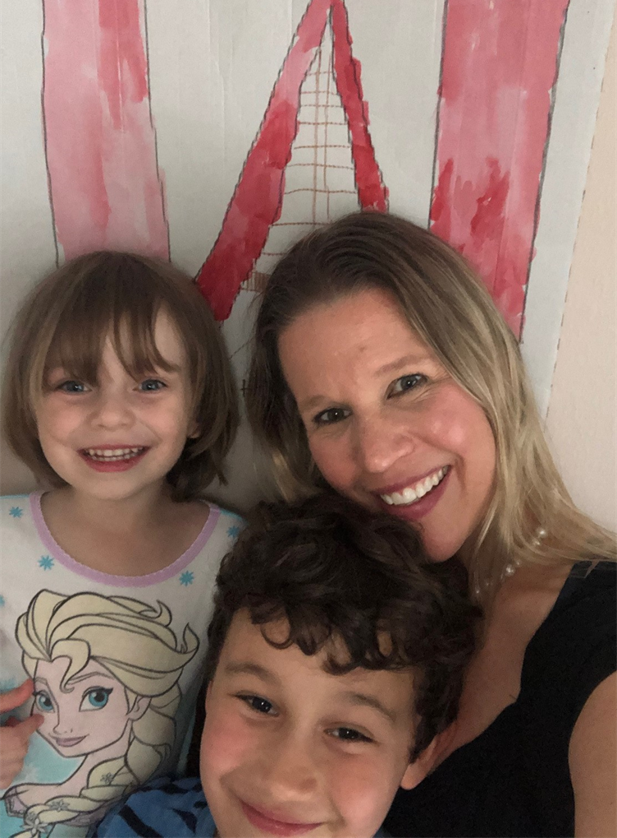
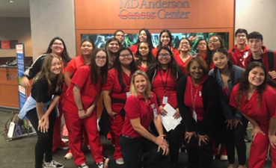
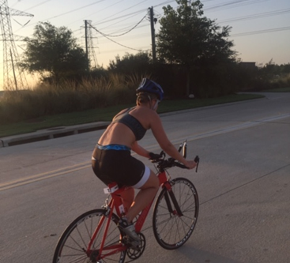
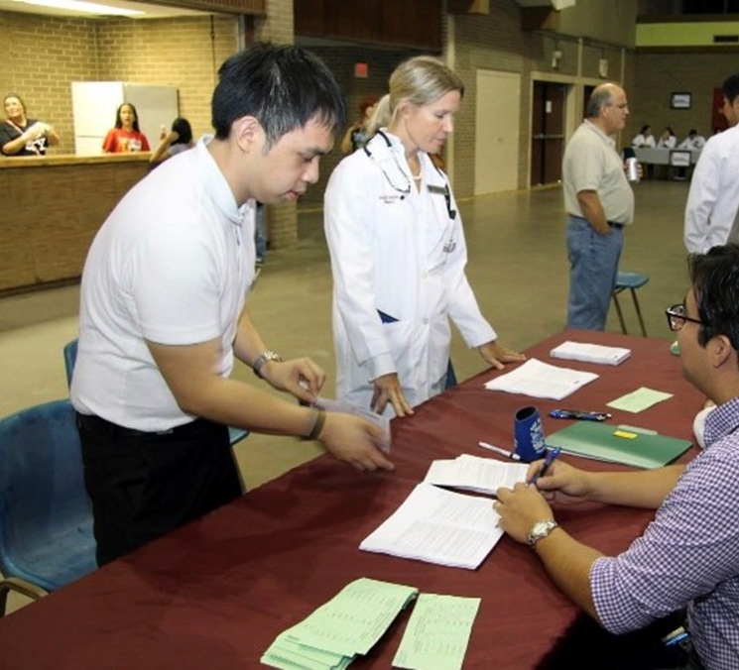

Slide 5
Course expectations
Communication is the key to success. Use email, Remind, or TEAMs chat to keep me informed.
Use email for professional communication requests and always include your class period.
Attend the class and participate in the class discussions.
Turn in assignments on-time (by 11:59 PM on the due date), or send a professional email requesting an extension.
Submit ALL work via the HUB unless otherwise instructed. Note: HUB not set-up yet, thanks for your patience.
Follow the class syllabus and calendar of events posted on the Westside Wolves Faculty page.
Honesty and integrity are the traits of a Westside Wolf!

Slide 6
Teacher expectations
I will respond to all professional communication within one business day (except in the event of personal/family illness or emergency).
I will grade and post the assignments within one week of the due date. Note: this is for students who submit their work ON-TIME.
I will begin and end the class on time.
I will create and prepare interesting presentations and assignments to help all students gain knowledge and skills in Medical Terminology.
I will challenge all students to perform their best, and I will assist each student to help them achieve success in Medical Terminology.
I will treat all students with respect, compassion, and understanding; additionally, I will demonstrate at all times, the values, attitudes, skills, and knowledge (VASK) that are expected of health care professionals.

Slide 7
Contact information
Remind App: Text @DrHaroM to the number 81010
HISD Email: Anna.Haro@Houstonisd.org
Office Hours: Every day during lunch in classroom South 114. (Exceptions: When I am on duty during first half of lunch on Monday and Wednesday, you are still welcome to come and wait.)
Tutorials: Tuesday and Thursday during lunch and Thursday after school.

Slide 8
What is medical terminology
Medical Terminology is the knowledge (ology) of words used to communicate medical information in the health care field.
Throughout the year, we will study how to communicate like doctors, nurses, technicians, PT’s, pharmacists, medical assistants, and more.
We will learn medical terminology through a study of different diseases and treatments, focusing on the Cardiovascular System, Endocrine System, Nervous System, and the Immune System.

Slide 9
VASK
The VASK score will be part of your minor grades.
Values
Attitudes
Skills
Knowledge
VASK makes up the traits of a health care professional.
Students are expected to improve their VASK traits as the year progresses.

Slide 10
Class rule
Respect. That’s it.
Respect is the class rule.

Slide 11
questions
Ask questions in class or:
Email me: Anna.Haro@Houstonisd.org
Send me a message via Remind
Join me during Office Hours in room South 114
See you soon!

Slide 12
exit ticket
Before you leave, finish your QR survey (first semester feedback).
In your small groups, create a respect “poster”
What does respect mean to you? Who do you respect and why? What are the qualities that you respect in others?

